Slide 1
Team DJJX
Jordan Pflum, Jason Petri, Dylan Nikol, Xuxian Chen

Slide 2
Overview
WRDS Data Collection and Manipultation
Universe Creation
Data Processing
Explanatory Variables
Paper Comparison

Slide 3
WRDS Data Collection and Manipultation
Crsp/Compustat Merged Quarterly:
Accounting numbers, Firm Information.
Convert fiscal quarter to calendar quarter
Lag the accounting data by 2 months (account for 60 release for quarterly data)
Crsp Monthly & Daily:
Share, Price, Factors, Return, etc.
calculated Daily Sigma
S&P 500:
total value & value weighted returns
10K / 10Q:
Similarity measures & minimum edit distances
Time Range:
1960-01-01 to 2019-12-31

Slide 4
Universe Creation
Exclude Finance, Insurance, and Real Estate companies (SIC 6000-6999)
Include Companies within US Exchanges (EXCHCD 11-20)
Include only ordinary common shares of US incorporated companies (Share code 10, 11)
Include companies with SHRCLS = ‘A’ or NaN
Exclude Company Returns with missing return codes (RET < -50)
Merge all datasets on PERMNO & DATE (month)

Slide 5
Data Processing
crsp_compustat_merged | original | Remove SIC in 6000s Keep Only American
# of row | 1,144,365 | 845,476
# of company | 25,471 | 19,035
df | NaN
# of row | 1,573,986
# of company | 14,181
crsp_monthly | original | Remove SIC in 6000s, Share Code = 10 or 11 Share Class = A or nan Return > -50
# of row | 4,256,427 | 2,600,005
# of company | 33,097 | 20,458
Crsp Daily
S&P 500

Slide 6
Explanatory Variables
10 variables created (8 Fundamental + 3 Text)
Net Income per Adjusted Total Assets (NITA)
Net Income per Enterprise Value (NIMTA)
Total Liabilities per Adjusted Total Assets (TLTA)
Total Liabilities Per Enterprise Value (TLMTA)
Excess Returns (EXRET)
Relative Size (RSIZE)
Standard Deviation of Returns (SIGMA)
Cash Per Enterprise Value (CASHMTA)
Three types of document similarities between the current filing and the previous filing (10-K & 10-Q)

Slide 7
Predictor Variable (Bankruptcy)
Two Possible Sources
CRSP/COMPUSTAT Merged: Research Company Reason for Deletion (DLRSN)
Provides reason for why company has been deleted from CRSP (code==02 → Bankruptcy)
Accompanied by Research Company Reason for Deletion Date (DLDTE)
CRSP: Delisting Code (DLSTCD)
Signals that the security is active/inactive for a particular reason (code==574 → Bankruptcy)

Slide 8
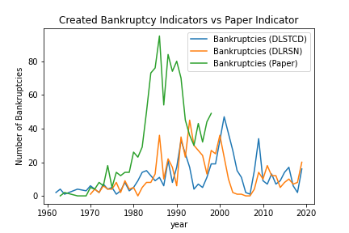
Paper Comparison: Firm Bankruptcies

Slide 9
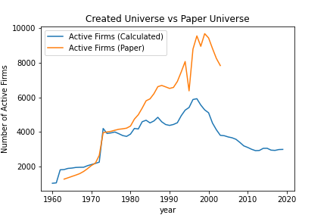
Paper Comparison: Universe Selection

